Slide 1
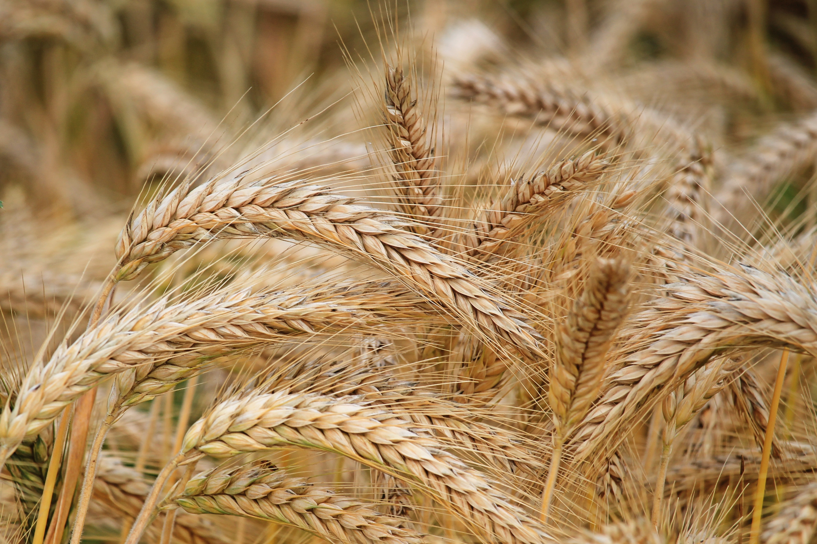
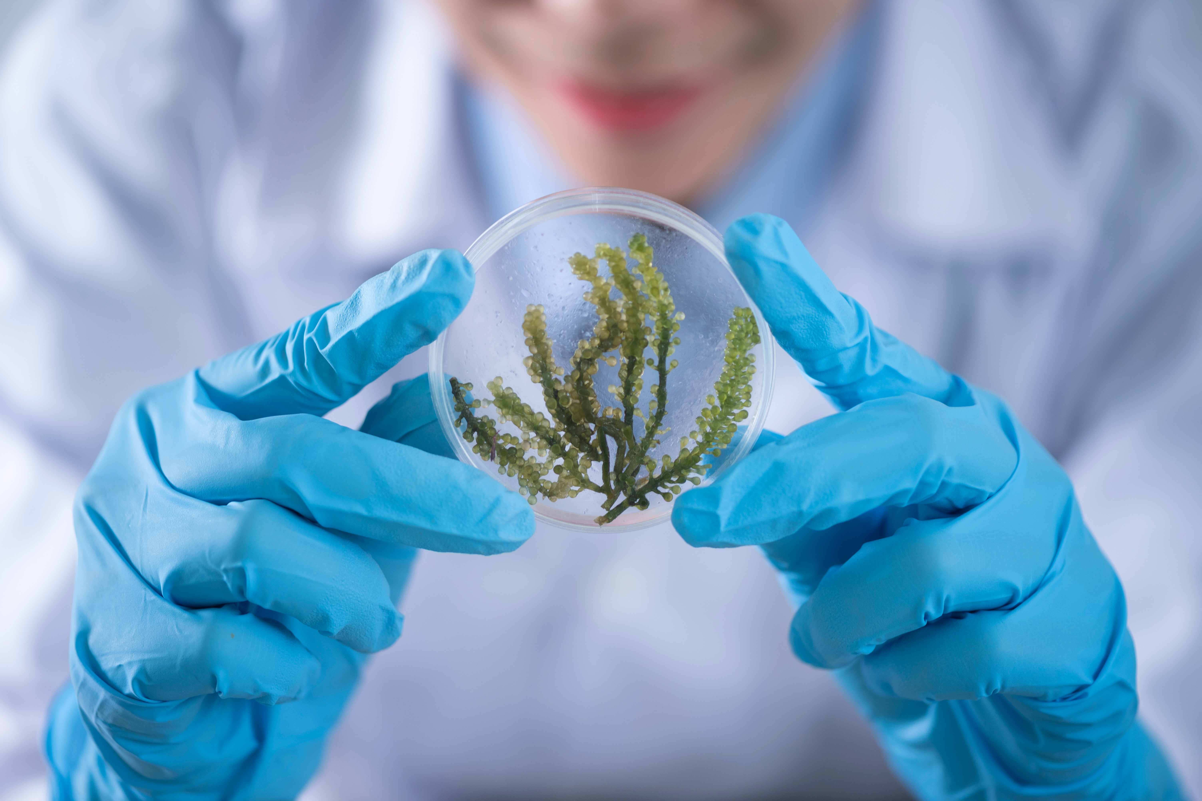
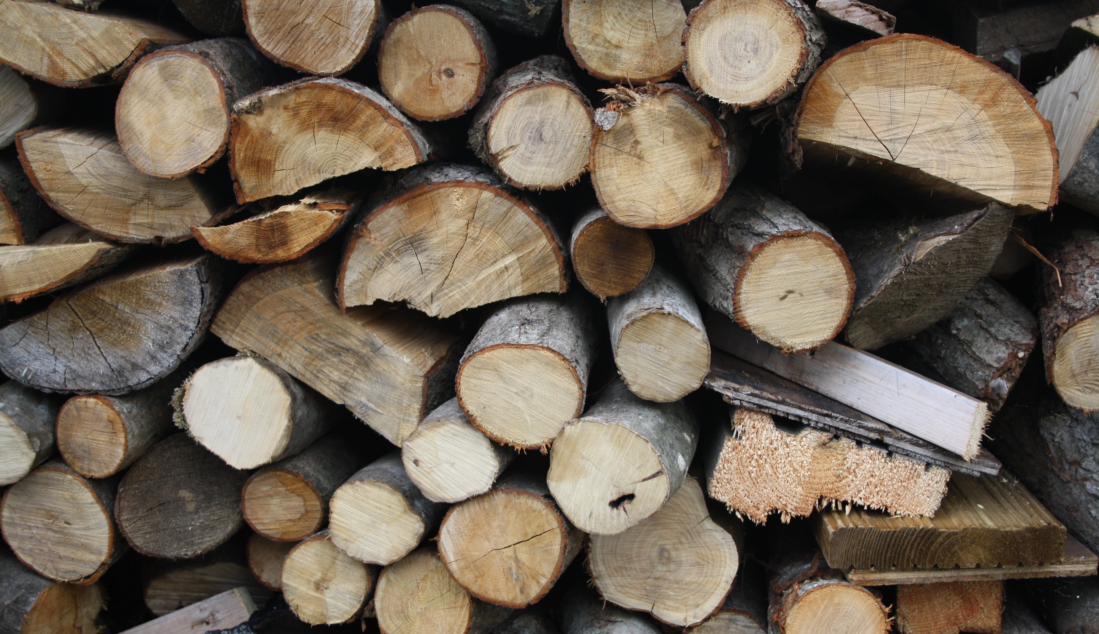
BIOECONOMY ELLS Summer School
How can we TRANSFORM from a fossil- to a BIO-BASED-ECONOMY?
Find your answer to the question and join the interdisciplinary ELLS Summer School!
What to expect…
• international guest speakers from ELLS universities
• excursion to ‘ best practice‘ viennese businesses
• get to know international students, practice your english skills
When ? 16th – 27th of August
Where ? BOKU University, Vienna
Who? YOU (Phd and Master students preferred)
Application Deadline : 30th of April on our ELLS Website

